Slide 1

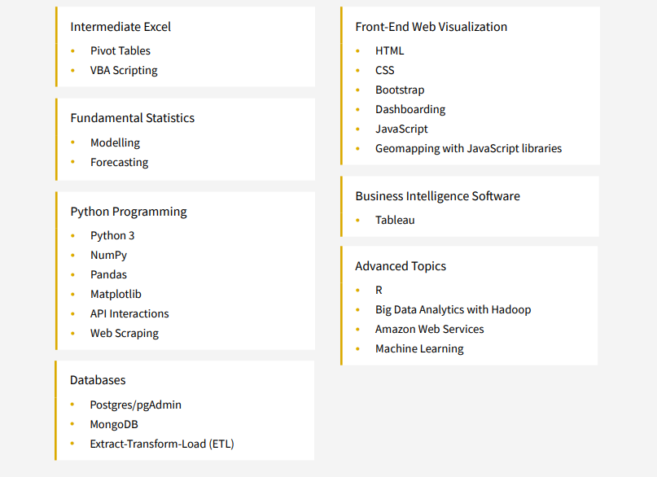
Intensive 24-week online program is fast-paced and focuses on the technical skills needed to solve real-world data problems.
Gain proficiency in numerous in-demand technologies, including Excel, Python, JavaScript, SQL Databases, Tableau, Machine Learning, and more
Final Project due in Mid-August 2022

Slide 2
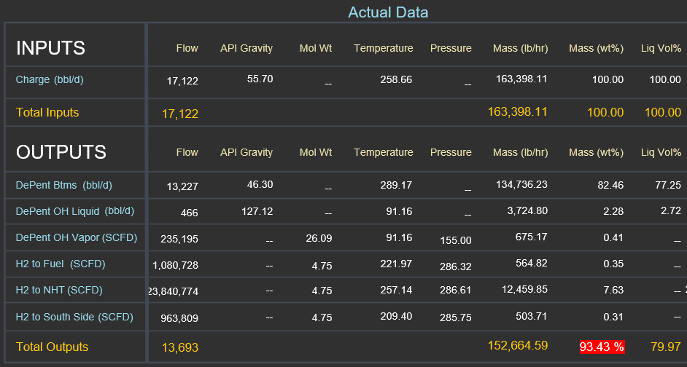
Idea #1: Streamline Mass Balance Troubleshooting
Utilize statistical variability and principal component analysis, develop machine learning methods to predict probably faulty meters.
Input Mass Balance Data with % Closure Qualifier
Outputs are probability percentages for each meter on accuracy.
Data Measure: meter creep, volume to mass ratios, meter fluctuation, correction factor fluctuation, etc.

Slide 3
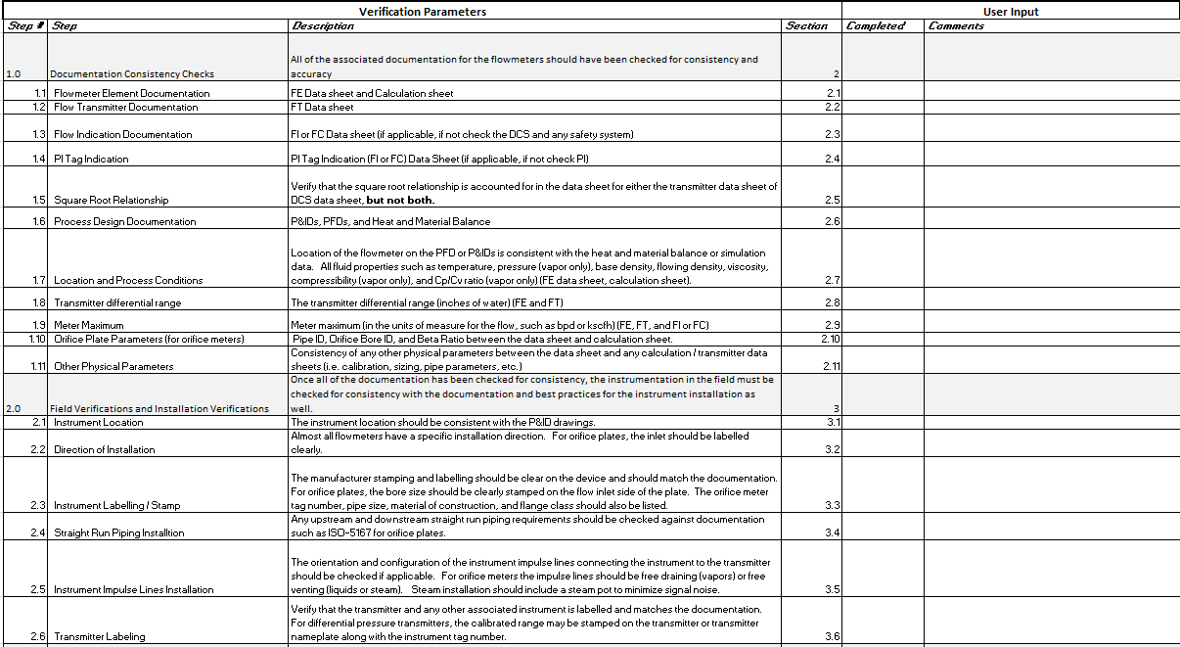
Idea #1: Current Mass Balance Troubleshooting Procedure
Current procedure is detailed and throughout at 36 steps
Selecting where to start a mass balance troubleshoot analysis is very hard
ML Model goal is to input Mass Balance Data and tell us the statistical probability of each meter’s contribution to any error over or under 100% mass balances closure
* Showing steps 1 – 18 of 36 step procedure

Slide 4
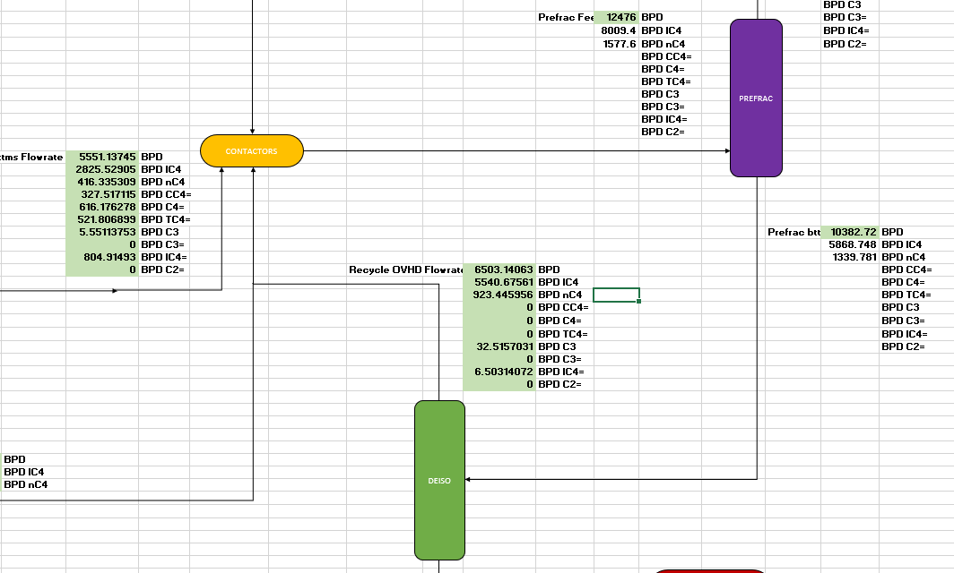
Idea #2– N-Butane Recycle Build Up in Unit X Contactor
Utilize statistical variability and principal component analysis, develop machine learning methods to predict probably of N-Butane build up at X unit contactors.
Input Unit X asset raw data, twice daily N-Butane samples for qualifier
Outputs are probability percentage that we are building or purging N-Butane.

Slide 5
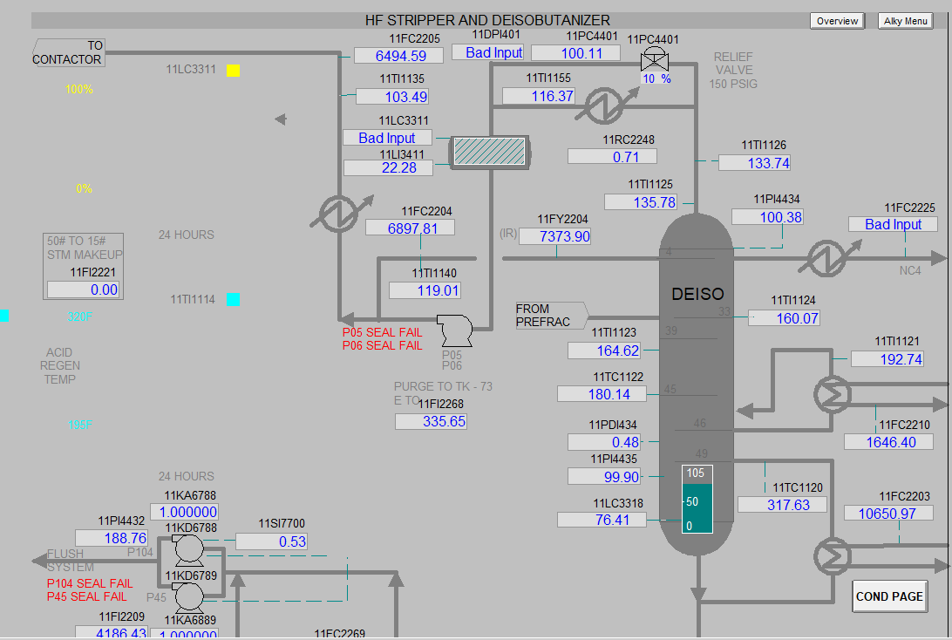
Idea #2 Current N-Butane Operating Procedure
No side-draw for N-Butane at DeX Tower, RVP penalty for dropping i-Butane is sever
Current procedure is relying on twice daily samples
Operations are blind in-between samples, as is efforts to measure N-Butane balance
Operations have noticed correlations with DeX Tower overhead temperature ( >135F) as early warning of N-C4 build up.
ML Model goal is to input all tower and contactor data and predict the statistical probability that we are in a “N-Butane Build-Up” mode

Slide 6

Idea #3: Phish Set-List Predictor
Phish: Vermont based Jam Band
Over 300 songs, of which greater than 200 are still in their live set-list rotation
Problem: You want to predict the likelihood of you favorite songs being played at the upcoming Phish show

Slide 7
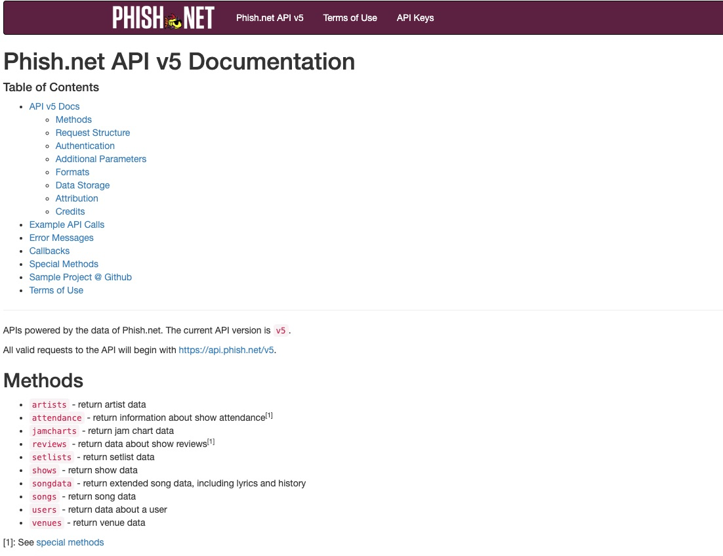
Idea #3: Phish Set-List Predictor
Phish.net has an open web API
Live show and set-list data going back to 1983
Train model based on previous set list, location, show number of tour, date, etc. to predict the next show’s set-list and determine if you should fork over $200 for tickets.

